Slide 1

SMART INDIA HACKATHON 2026
TITLE PAGE
Problem Statement ID – 26127
Problem Statement Title- City-Wide AI Engine for Multi-Camera ANPR Trajectory Tracking and Urban Traffic Analytics
Theme- Smart Automation
PS Category- Software
Team ID-143680
Team Name - NeuraTrack

Slide 2
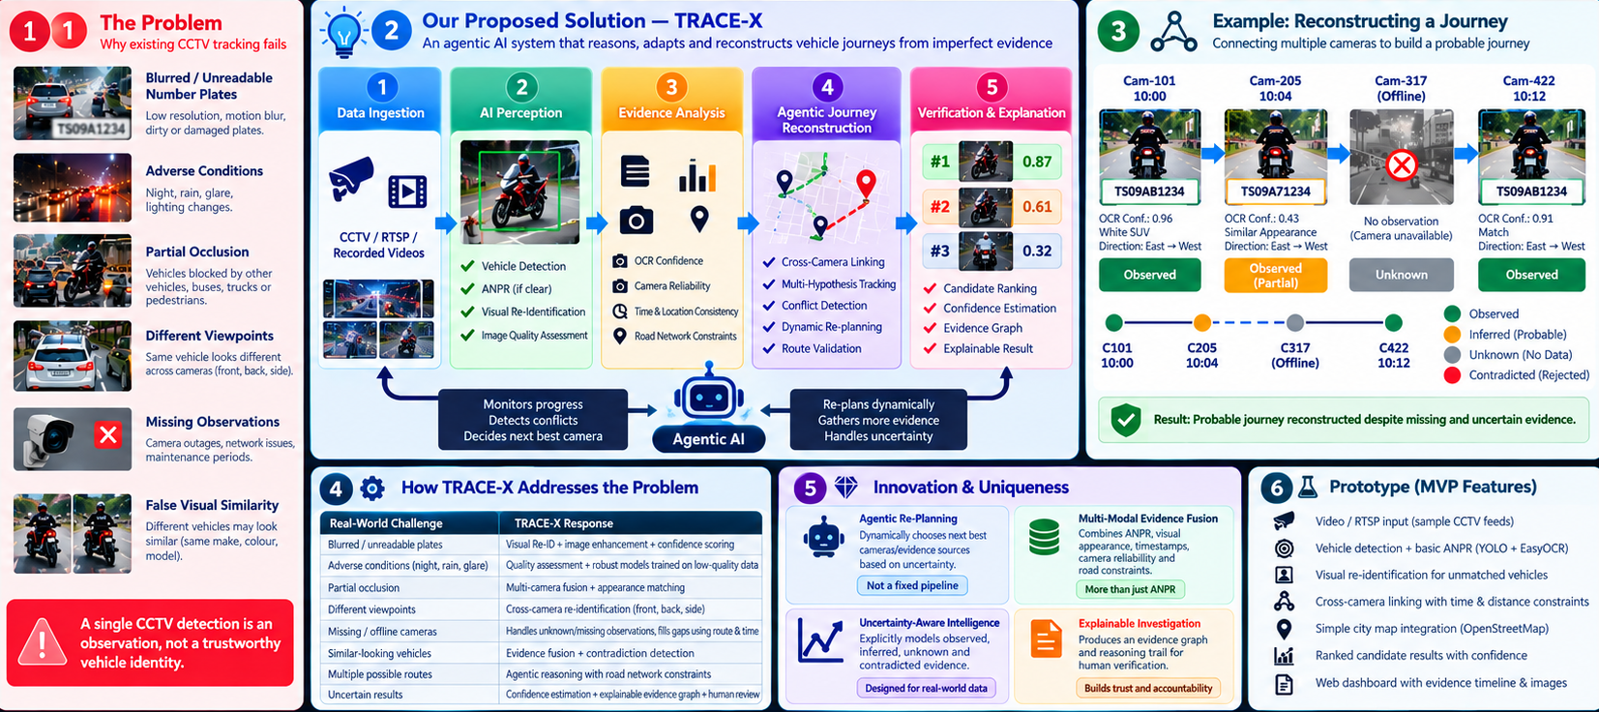
TRACE-X
Trust-Aware Multi-Camera Vehicle Intelligence for Urban Traffic Analytics
Neura
Track
TRACE-X Solution Pipeline

Slide 3
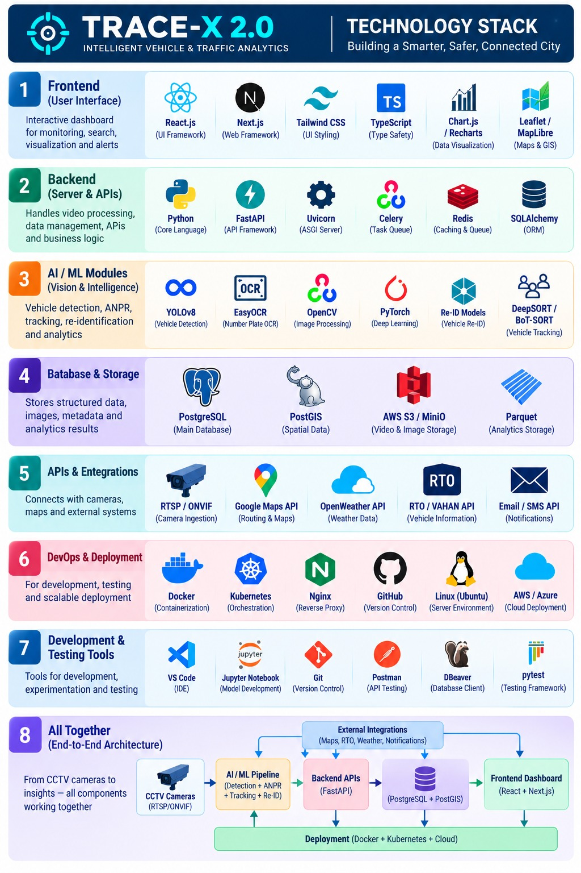
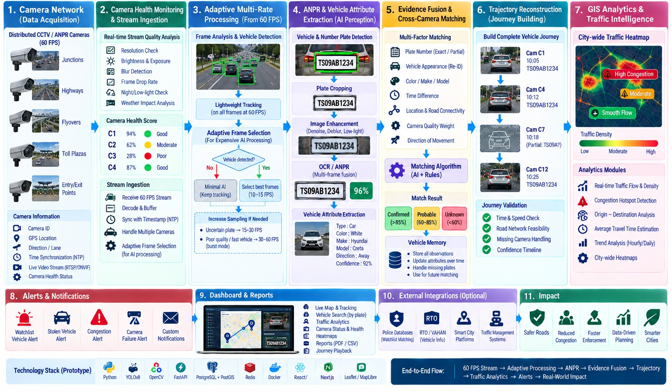



TECHNICAL APPROACH
Neura
Track

Slide 4













FEASIBILITY AND VIABILITY
Neura
Track
FEASIBILITY ANALYSIS
VIABILITY
BUSINESS POTENTIAL
Infrastructure Reusability:
Builds on existing CCTV/ANPR camera networks — no new hardware installation required.
Proven Concept:
Mirrors AI traffic-surveillance systems already live in major Indian cities.
Government Cost Savings:
Automates manual monitoring, cutting personnel hours and cost.
Scalable Deployment:
Pilot at a few key intersections first, then expand citywide zone-by-zone.
Builds Public Trust:
Automated, timestamped detection minimizes bias and gives auditable evidence.
New Revenue Generation:
OCR output integrates with e-challan systems for automated fines.
Cost-Effectiveness:
Open-source CV stack keeps setup cost low versus proprietary ANPR systems.
Authority Engagement:
Real-time dashboards keep control-room operators actively in the loop.
Faster Vehicle Recovery:
Cross-camera trajectory search cuts investigation to minutes.
Authority Integration:
Blacklist alerts, case management, and manual override for police control.
Guarantees Accountability:
Every detection, alert, and case action is logged and traceable.
Multi-City Scalability:
Same architecture licenses to other cities with local config only.
Data Readiness:
Police FIR records and camera metadata plug directly into the registry and blacklist.
Regulatory Alignment:
Fits existing FIR-linked enforcement and investigation workflows, no new legislation needed.
Analytics as a Product:
Aggregated data supports signal timing and infra planning.

Slide 5
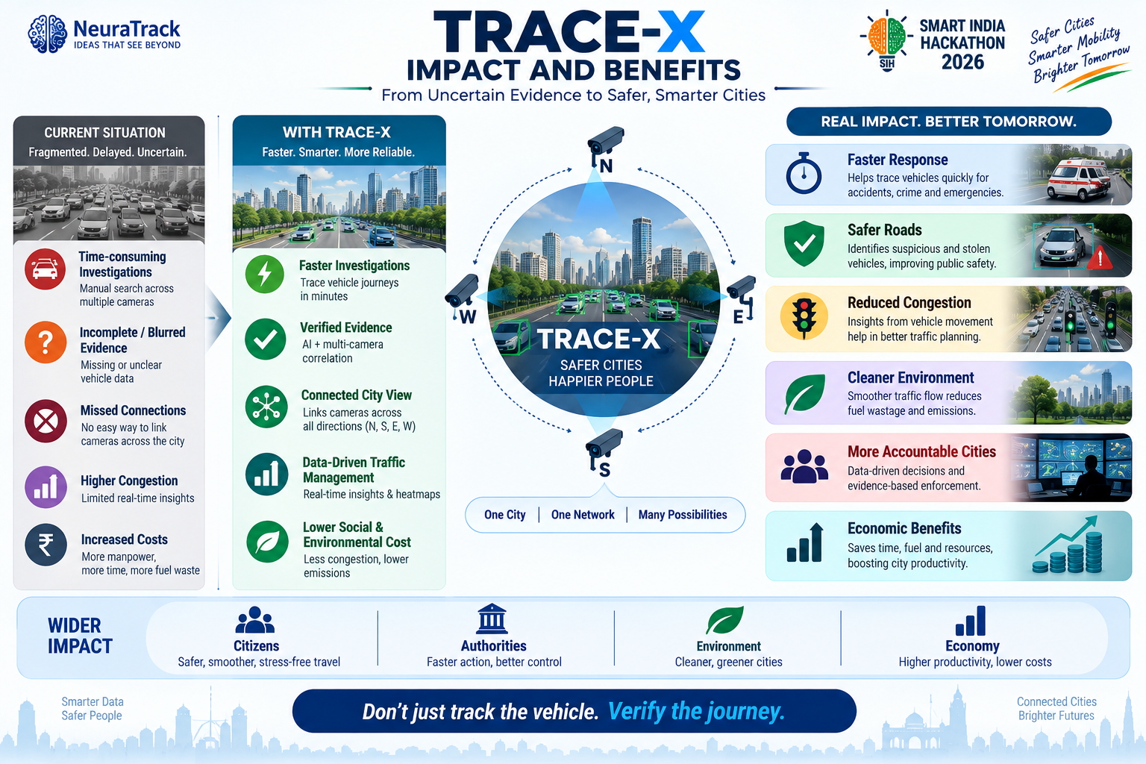
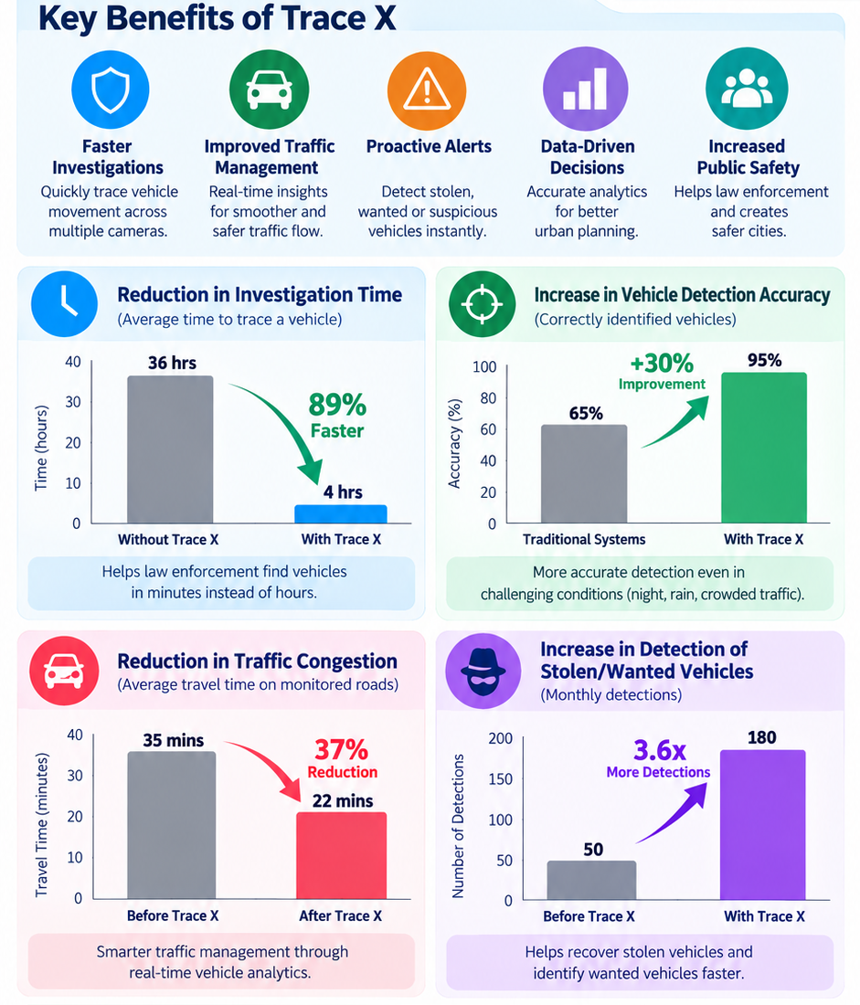


IMPACT AND BENEFITS
Neura
Track
Click For More info

Slide 6
RESEARCH AND REFERENCES
Neura
Track
2 TRACE-X RESEARCH EXTENSION
1 RESEARCH BASE
Indian ANPR • 2022
1
A. Confidence-aware evidence
Indian plate diversity makes direct transfer from non-Indian datasets difficult.
Every observation carries OCR, image-quality and camera-health confidence.
Multi-Camera Tracking • 2019
2
B. Multi-hypothesis journey
Visual + orientation + spatial-temporal cues improve vehicle tracking across cameras.
Keep competing routes instead of forcing one vehicle path when evidence is ambiguous.
City-Scale MCT • 2021
3
C. Negative + contradictory evidence
Re-ID + track matching + spatial-temporal information support city-scale traffic management.
Represent expected-but-unseen observations and reject physically inconsistent transitions.
Intelligent Camera Selection • 2022
4
D. Evidence-driven camera selection
Camera-selection policies can reduce unnecessary Re-ID queries and computation.
Choose the next camera/time-window by expected information gain, not only proximity.
3 VALIDATION FOUNDATION
Links
Hyderabad CCTV
Indian ANPR
IITH_Helmet2 / IITH_Accident
Indian plate dataset + BARC study
City-scale benchmark
Road network
CityFlow / AI City
OpenStreetMap for GIS topology

